Slide 1
Spectral Clustering
Course: Cluster Analysis and Other Unsupervised Learning Methods (Stat 593 E)
Speakers: Rebecca Nugent^{1,} Larissa Stanberry²
Department of ¹ Statistics, ² Radiology,
University of Washington

Slide 2
Outline
What is spectral clustering?
Clustering problem in graph theory
On the nature of the affinity matrix
Overview of the available spectral clustering algorithm
Iterative Algorithm: A Possible Alternative

Slide 3
Spectral Clustering
Algorithms that cluster points using eigenvectors of matrices derived from the data
Obtain data representation in the low-dimensional space that can be easily clustered
Variety of methods that use the eigenvectors differently

Slide 4
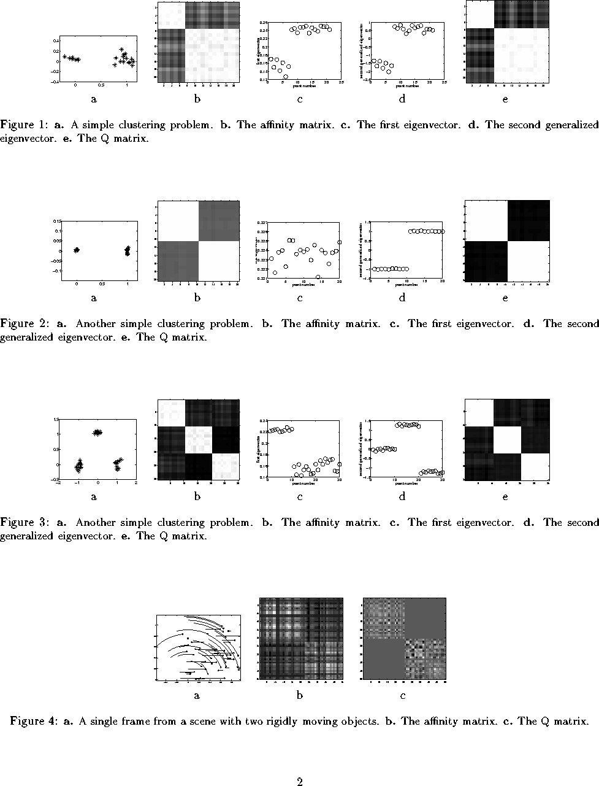
Data-driven Method 1 Method 2
matrix
Data-driven Method 1 Method 2
matrix
Data-driven Method 1 Method 2
matrix

Slide 5
Spectral Clustering
Empirically very successful
Authors disagree:
  Which eigenvectors to use
  How to derive clusters from these eigenvectors
Two general methods

Slide 6
Method #1
Partition using only one eigenvector at a time
Use procedure recursively
Example: Image Segmentation
  Uses 2nd (smallest) eigenvector to define optimal cut
  Recursively generates two clusters with each cut

Slide 7
Method #2
Use k eigenvectors (k chosen by user)
Directly compute k-way partitioning
Experimentally has been seen to be “better”

Slide 8
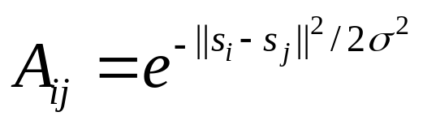
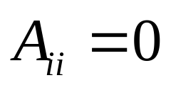
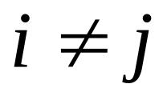
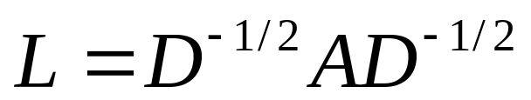
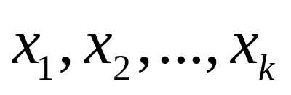
Spectral Clustering Algorithm Ng, Jordan, and Weiss
Given a set of points S={s₁,…s_{n}}
Form the affinity matrix
Define diagonal matrix D_{ii}= Σ_{κ} a_{ik}
Form the matrix
Stack the k largest eigenvectors of L to form
the columns of the new matrix X:
Renormalize each of X’s rows to have unit length. Cluster rows of Y as points in R ^{k}

Slide 9
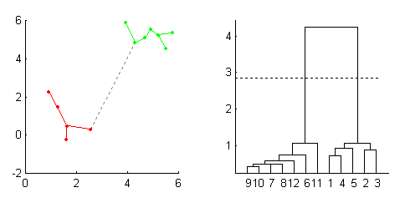
Cluster analysis & graph theory
Good old example : MST ←→ SLD
Minimal spanning tree is the graph of minimum length connecting all data points. All the single-linkage clusters could be obtained by deleting the edges of the MST, starting from the largest one.

Slide 10
Cluster analysis & graph theory II
Graph Formulation
View data set as a set of vertices V={1,2,…,n}
The similarity between objects i and j is viewed as the weight of the edge connecting these vertices A_{ij}. A is called the affinity matrix
We get a weighted undirected graph G=(V,A).
Clustering (Segmentation) is equivalent to partition of G into disjoint subsets. The latter could be achieved by simply removing connecting edges.

Slide 11

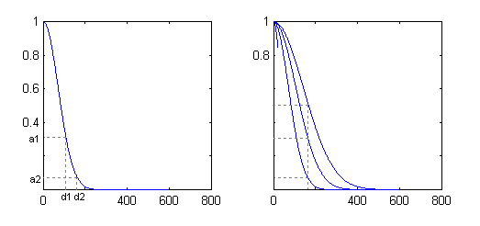
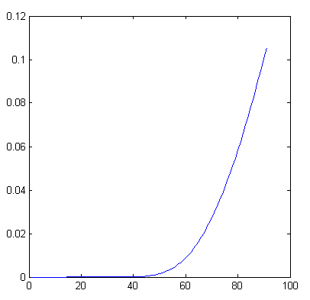
Nature of the Affinity Matrix
“closer” vertices will get larger weight
Weight as a function of σ

Slide 12
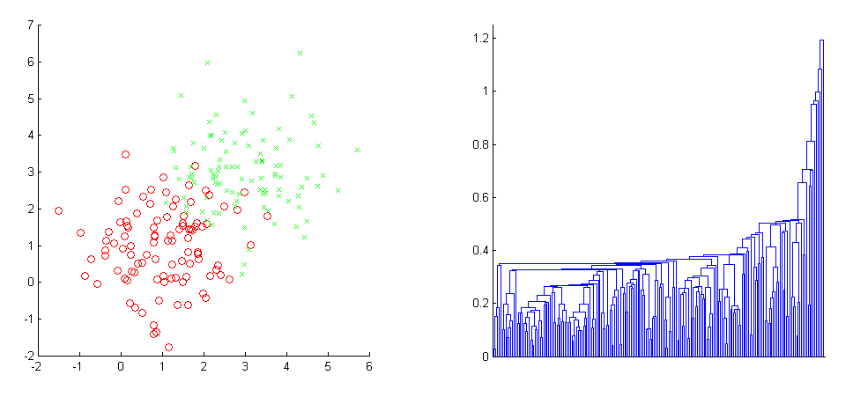
Simple Example
Consider two 2-dimensional slightly overlapping Gaussian clouds each containing 100 points.

Slide 13
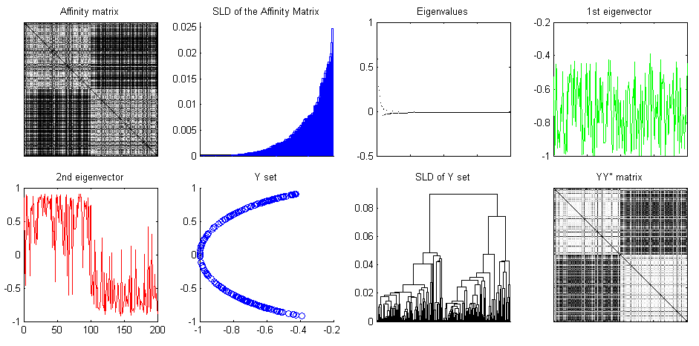
Simple Example cont-d I

Slide 14
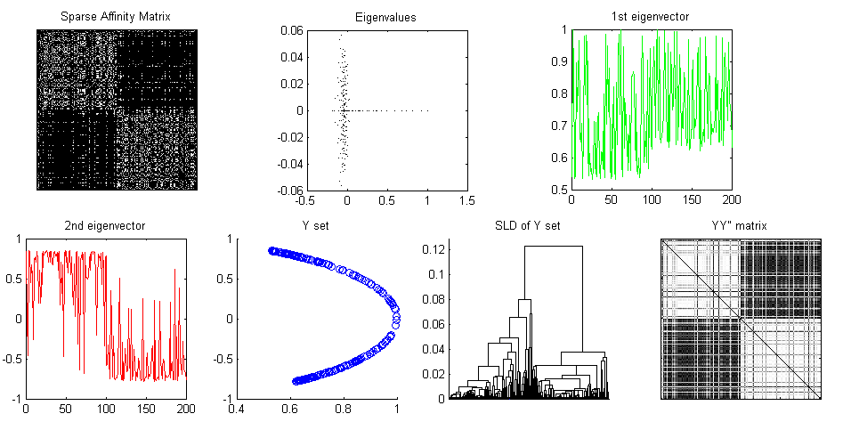
Simple Example cont-d II

Slide 15

Magic σ
Affinities grow as grows →
How the choice of σ value affects the results?
What would be the optimal choice for σ?

Slide 16
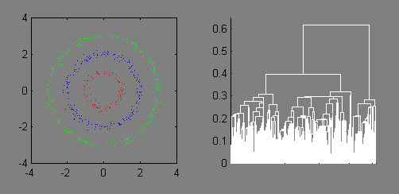
Example 2 (not so simple)

Slide 17
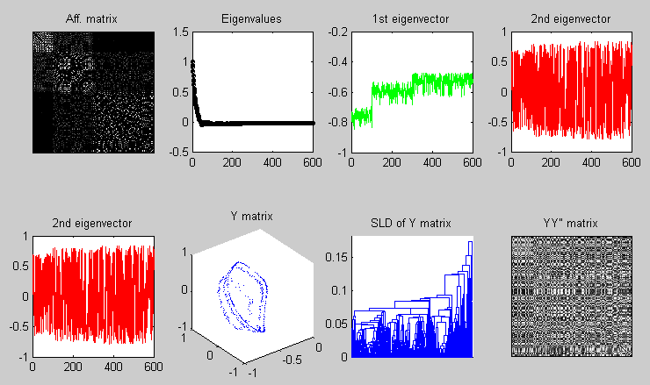
Example 2 cont-d I

Slide 18
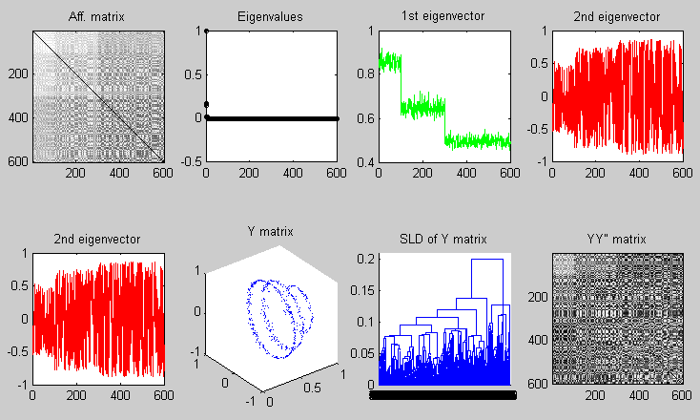
Example 2 cont-d II

Slide 19
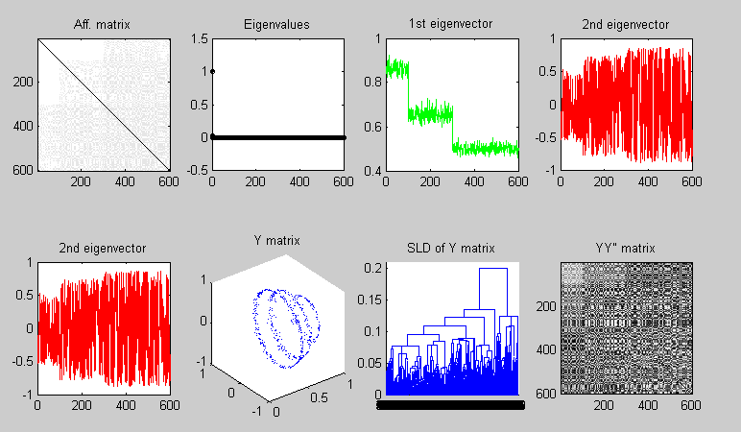
Example 2 cont-d III

Slide 20
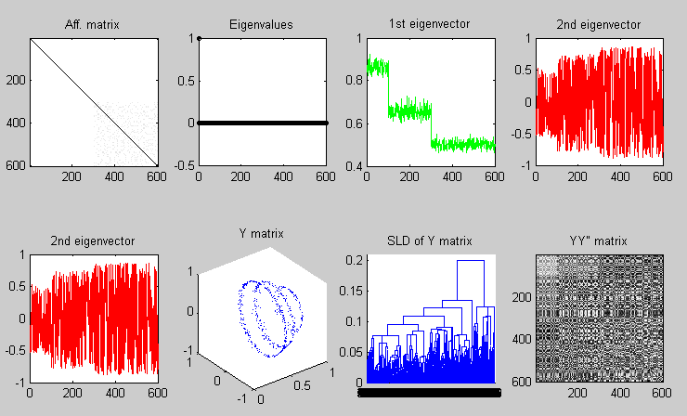
Example 2 cont-d IV

Slide 21
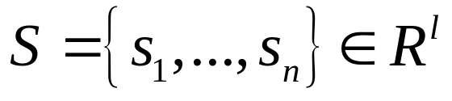
Spectral Clustering Algorithm Ng, Jordan, and Weiss
Motivation
  Given a set of points
  We would like to cluster them into k subsets

Slide 22
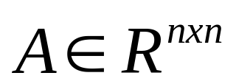
Algorithm
Form the affinity matrix
Define if
  Scaling parameter chosen by user
Define D a diagonal matrix whose
(i,i) element is the sum of A’s row i

Slide 23
Algorithm
Form the matrix
Find , the k largest eigenvectors of L
These form the the columns of the new matrix X
  Note: have reduced dimension from nxn to nxk

Slide 24
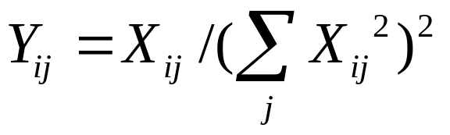

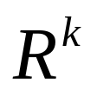
Algorithm
Form the matrix Y
  Renormalize each of X’s rows to have unit length
  Y
Treat each row of Y as a point in
Cluster into k clusters via K-means

Slide 25
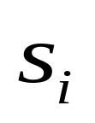
Algorithm
Final Cluster Assignment
  Assign point to cluster j iff row i of Y was assigned to cluster j

Slide 26
Why?
If we eventually use K-means, why not just apply K-means to the original data?
This method allows us to cluster non-convex regions

Slide 27
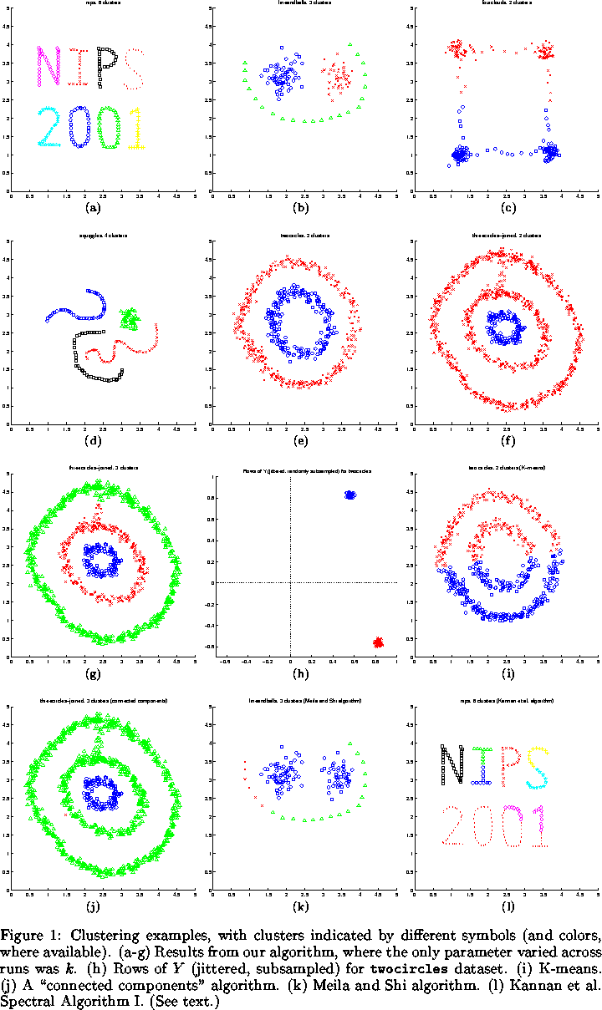

Slide 28
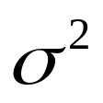
User’s Prerogative
Choice of k, the number of clusters
Choice of scaling factor
  Realistically, search over and pick value that gives the tightest clusters
Choice of clustering method

Slide 29


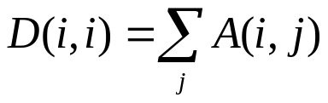
Comparison of Methods
Authors | Matrix used | Procedure/Eigenvectors used
Perona/ Freeman | Affinity A | 1st x: Recursive procedure
Shi/Malik | D-A with D a degree matrix | 2nd smallest generalized eigenvector Also recursive
Scott/ Longuet-Higgins | Affinity A, User inputs k | Finds k eigenvectors of A, forms V. Normalizes rows of V. Forms Q = VV’. Segments by Q. Q(i,j)=1 -> same cluster
Ng, Jordan, Weiss | Affinity A, User inputs k | Normalizes A. Finds k eigenvectors, forms X. Normalizes X, clusters rows

Slide 30
Advantages/Disadvantages
Perona/Freeman
  For block diagonal affinity matrices, the first eigenvector finds points in the “dominant”cluster; not very consistent
Shi/Malik
  2nd generalized eigenvector minimizes affinity between groups by affinity within each group; no guarantee, constraints

Slide 31
Advantages/Disadvantages
Scott/Longuet-Higgins
  Depends largely on choice of k
  Good results
Ng, Jordan, Weiss
  Again depends on choice of k
  Claim: effectively handles clusters whose overlap or connectedness varies across clusters

Slide 32
Affinity Matrix Perona/Freeman Shi/Malik Scott/Lon.Higg
1st eigenv. 2nd gen. eigenv. Q matrix
Affinity Matrix Perona/Freeman Shi/Malik Scott/Lon.Higg
1st eigenv. 2nd gen. eigenv. Q matrix
Affinity Matrix Perona/Freeman Shi/Malik Scott/Lon.Higg
1st eigenv. 2nd gen. eigenv. Q matrix

Slide 33
Inherent Weakness
At some point, a clustering method is chosen.
Each clustering method has its strengths and weaknesses
Some methods also require a priori knowledge of k.

Slide 34
One tempting alternative
The Polarization Theorem (Brand&Huang)
Consider eigenvalue decomposition of the affinity matrix VΛV^{T}=A
Define X=Λ^{1/2}V^{T}
Let X_{(d)} =X(1:d, :) be top d rows of X: the d principal eigenvectors scaled by the square root of the corresponding eigenvalue
A_{d}=X_{(d)}^{T}X_{(d)} is the best rank-d approximation to A with respect to Frobenius norm (||A||_{F}²=Σa_{ij}²)

Slide 35
The Polarization Theorem II
Build Y_{(d)} by normalizing the columns of X_{(d)} to unit length
Let Θ_{ij} be the angle btw x_{i},x_{j} – columns of X_{(d)}
Claim
As A is projected to successively lower ranks A_{(N-1)}, A_{(N-2),} … , A_{(d),} … , A_{(2),} A₍₁₎, the sum of squared angle-cosines Σ(cos Θ_{ij})² is strictly increasing

Slide 36
Brand-Huang algorithm
Basic strategy: two alternating projections:
  Projection to low-rank
  Projection to the set of zero-diagonal doubly stochastic matrices (all rows and columns sum to unity)
    stochastic matrix has all rows and columns sum to unity

Slide 37
Brand-Huang algorithm II
While {number of EV=1}<2 do
  A→P→A(d)→P→A(d)→ …
    Projection is done by suppressing the negative eigenvalues and unity eigenvalue.
The presence of two or more stochastic (unit)eigenvalues implies reducibility of the resulting P matrix.
  A reducible matrix can be row and column permuted into block diagonal form

Slide 38
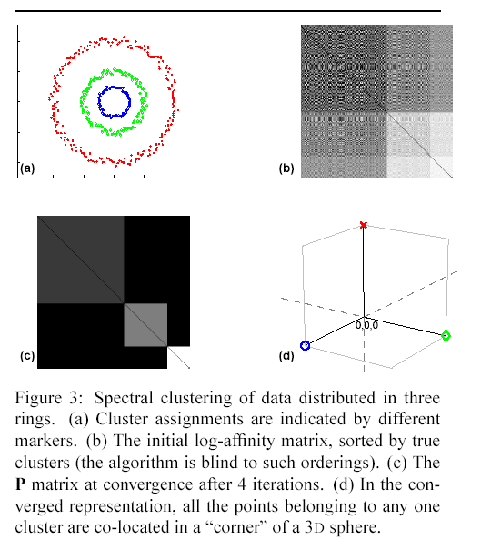
Brand-Huang algorithm III

Slide 39
References
Alpert et al Spectral partitioning with multiple eigenvectors
Brand&Huang A unifying theorem for spectral embedding and clustering
Belkin&Niyogi Laplasian maps for dimensionality reduction and data representation
Blatt et al Data clustering using a model granular magnet
Buhmann Data clustering and learning
Fowlkes et al Spectral grouping using the Nystrom method
Meila&Shi A random walks view of spectral segmentation
Ng et al On Spectral clustering: analysis and algorithm
Shi&Malik Normalized cuts and image segmentation
Weiss et al Segmentation using eigenvectors: a unifying view

